Slide 1
Dollars & Sense:
How to Build Your Financial Wellness
Presented by Jordan Gray

Slide 2

Topics to Cover
Why Financial Literacy Matters
Assessing your Current Financial Health
Creating a Budget
Saving for Goals
Managing Debt
Building Credit Responsibly
Understanding Investments
Avoiding Common Financial Mistakes
Resources for Continued Learning

Slide 3
Why Financial Literacy Matters
Enables better decision making
Reduces stress and anxiety
  Per an American Psychological Association survey in 2022, 56% of respondents had to make a different choice due to a lack of money in the past month.
Prepares for emergencies
  Medical expenses
  Car repair
  Losing a job
Makes future goals achievable
  Car or home purchases
  Vacation
Helps protect your money
  Money accruing in interest bearing accounts making it “work” for you.
  Having it in FDIC covered accounts.

Slide 4

Assessing Your Current Financial Health
Track all income and expenses
  Can use tools such as excel, google sheets, or just simple pen and paper
Review bank statements each month
  Provided via email notice or paper statement from bank
Identify spending patterns and red flags
  Bank account constantly negative?
  Unknown transactions from your account?
  Creditors calling you for owed money?
Check credit report annually
  3 Credit Bureaus: Transunion, Experian, Equifax

Slide 5
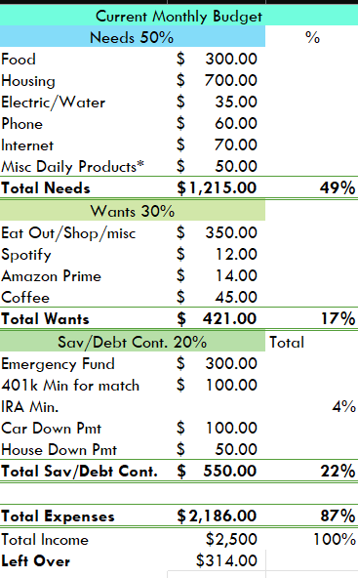
Creating a Budget
Use google sheets, excel, a journal, a phone app, etc
List all monthly expenses
  Utility Bills
  Rent
  Phone
List monthly income
  Jobs
  Social Security
  Investments
50/30/20 rule
  50% of Income to Needs: Groceries, utilities, cell phone,
  30% of income to Wants: snacks, streaming services, newest phone, trips
  20% of income to savings or debts: savings account, loans, IRAs, HSA, medical debt

Slide 6
Creating a Budget (continued)
Utilize multiple bank accounts for expense organization
  Subscription Bills
  Car/Home
  Fun Money
  Vacation
Just because a bill is not due this month doesn’t mean you don’t have to save for it. (insurance, annual subscriptions, car registration)
Utilize a tracking app. (many are free)
Try your best to get a grocery budget down. (stores charge different prices for same food products)
End goal is to get an idea of how much money you have to move around.

Slide 7


Saving for Goals
Understanding your passions in life and what does and doesn’t matter can help to set future goals.
Short Term: Within 5 years
  Emergency fund (3-6 months expenses)
  New laptop
  Down payment on a car
  Upcoming vacation
Long Term: 5 + Years
  A home
  Retirement
  Education

Slide 8

Managing Debt
Good Debt
  Education
  Home Mortgage
  Planned loans for business
Bad Debt
  Pay day loans
  Credit Cards (when not paid in full)
Strategies to reduce existing debt
  Snowball Method: Payoff smallest debts first
  Avalanche Method: Pay highest interest debts first
Avoiding future debt
  Live within your means
  Avoid impulse spending
  Save over taking loans

Slide 9
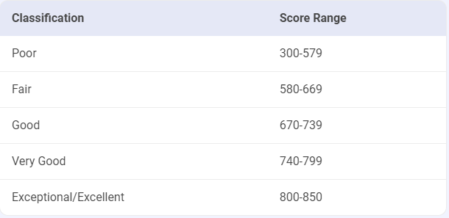

Building Credit Responsibly
A Credit Score is to show how good of a borrower an individual is. It’s calculated based off:
  Payment History (High impact on score)
  Credit card utilization (High impact on score)
  Derogatory marks (High impact on score)
  Age of credit history (medium impact on score)
  Total Accounts (low impact on score)
  Hard Inquires (low impact on score)
Importance
  Better credit can get lower interest rates
  More institutions willing to lend to you with good credit
  Some jobs look at credit score
Tips for a healthy score
  Pay bills on time
  Keep credit balance below 30% of total limit
  Review credit reports regularly
  Don’t apply for too many loans in a short period of time

Slide 10
Understanding Investments
Investments can be through multiple different institutions. From Community Banks, Brokerage Accts, the US Government, and more.
Types of Investments
  Stocks: Fluctuate each day, average yearly return around 8%
  Bonds: Fixed rate, more secure than stocks but lower rate
  CDs: Fixed rate terms
  HYSA: Variable rate account with higher interest than other savings accts
Common Investment vehicles
  IRAs: Traditional or Roth accounts managed by the individual
  401k: Managed by employers (may have company matches)
  HSAs: Triple tax advantaged account for medical expenses
  529 College Plan: Savings for child’s future education expenses

Slide 11
Avoiding Common Financial Mistakes
Save for most expenses over getting a loan
Pay credit cards in full each month
Avoid pay day loans (interest can be over 400%)
Don’t overdraft bank accounts (costly fees)
Don’t cosign on a loan for someone you wouldn’t be willing to pay by yourself.
Don’t overspend on wants
Make sure to pay taxes on time

Slide 12



Helpful Resources
Books: “Personal finance for dummies” “How to Money”
Websites: Nerdwallet, Investopedia, Youtube
Local Financial Planners
Local CPAs

Slide 13

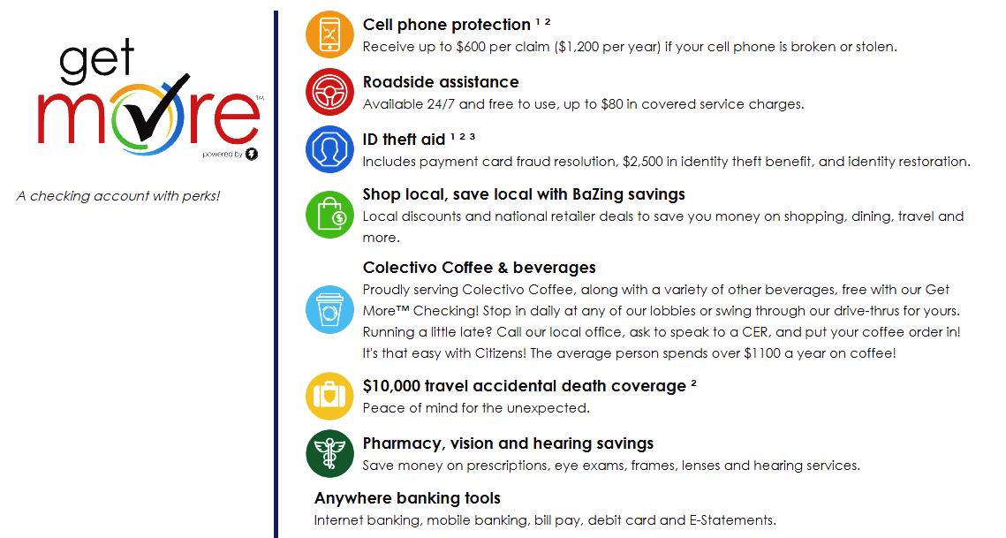
Value Added Services

Slide 14

Conclusion
Start with a budget
Save over borrow
50/30/20 Rule
Set Short & long terms goals
Pay debts on time
Invest in your future

Slide 15
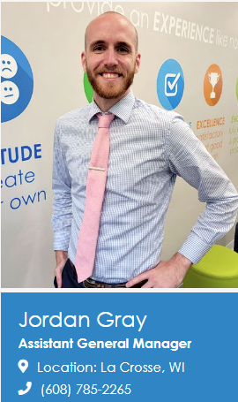
Questions?
Email: jgray@citizensstatebank.us
Website: https://citizensstatebank.us
Sign up for an Account today!
https://citizensstatebank.us/personal-banking/checking/citizensexp

